Slide 1
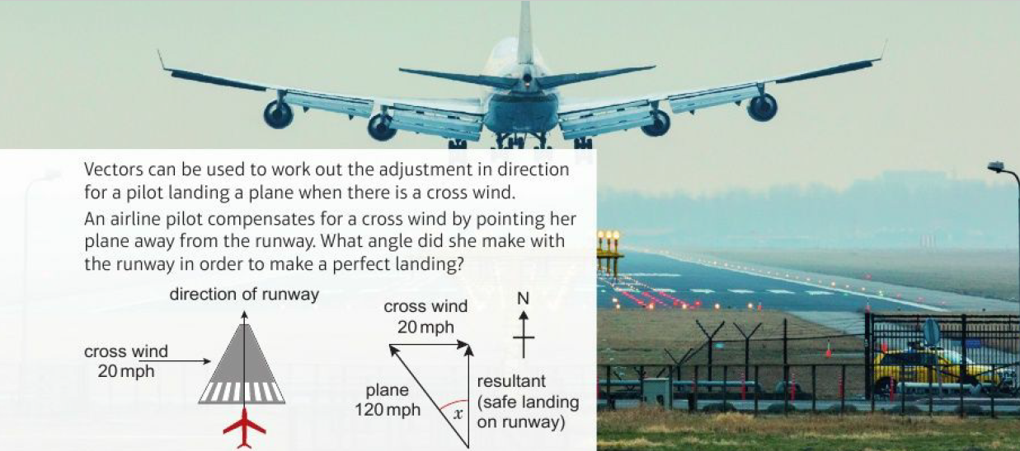
Mathematics (9-1) - iGCSE
2018-20
Year 09
Vectors can be used to work out the adjustment in direction for a pilot landing a plane when there is a cross wind.
An airline pilot compensates for a cross wind by pointing her plane away from the runway. What angle did she make with the runway in order to make a perfect landing?
Unit 18 – Vectors & Geometric Proof

Slide 2
Contents
Page iv
18 Vectors and geometric proof 557
Prior knowledge check 557
18.1 Vectors and vector notation 558
18.2 Vector arithmetic 560
18.3 More vector arithmetic 563
18.4 Parallel vectors and collinear points 566
18.5 Solving geometric problems 568
Problem-solving 572
Check up 574
Strengthen 576
Extend 579
Knowledge check 582
Unit test 584

Slide 3
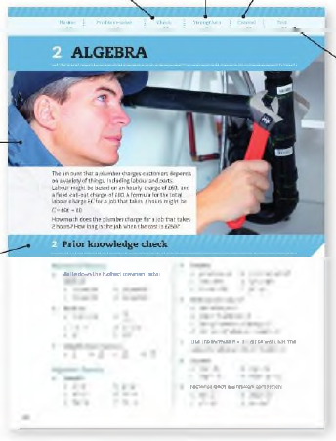
Contents
Page v
At the end of the Master lessons, take a check-up test to help you to decide whether to strengthen or Extend our learning
Extend helps you to apply the maths you know to some different situations
Unit Openers put the maths you are about to learn into a real-life context. Have a go at the question - it uses maths you have already learnt so you should be able to answer it at the start of the unit.
When you have finished the whole unit, a Unit test helps you see how much progress you are making.
Choose only the topics in strengthen thay you need a bit more practice with. You’ll find more hints here to lead you through specific questions. Then move on to Extend
Use the Prior knowledge check to make sure you are ready to start the main lessons in the unit. It checks your knowledge from Key Stage 3 and from earlier in the GCSE course. Your teacher has access to worksheets if you need to recap anything.

Slide 4
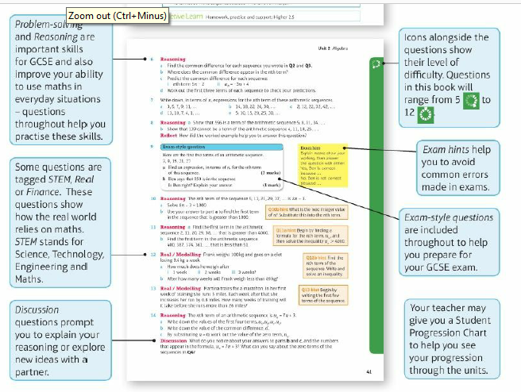
Contents
Page vi

Slide 5
18 – Prior Knowledge Check
Page 557
Numerical fluency
PQ = $\frac{2}{3}$PR P R Work out
PQ:PR b. RQ:PR
PQ:QR
The point M divides the line LX in the ratio 5:2. L X Copy and complete
LM = LX b. MX = LX
LX = MX
●
Q
●
M
$$\frac{□}{□}$$
$$\frac{□}{□}$$
$$\frac{□}{□}$$

Slide 6
18 – Prior Knowledge Check
Page 557
Numerical fluency
Write each surd in its simplest form,
$\sqrt{27}$ b. $\sqrt{80}$
$\sqrt{75}$ d. $\sqrt{112}$
Algebraic Fluency
Simplify
4x + 3y - x + 2y
3(2x - 3)
2(3a - b)+ $\frac{2}{3}$(6a + 9b)

Slide 7
18 – Prior Knowledge Check
Page 557
Algebraic Fluency
Sketch these shapes,
isosceles triangle
isosceles trapezium
square d. rhombus
parallelogram
Mark any
equal sides
parallel sides.
Find x. Give your answer to 3 significant figures (3 s.f.).

Slide 8
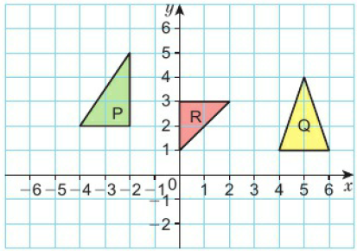
18 – Prior Knowledge Check
Page 558
Algebraic Fluency
Copy the diagram: Translate shape
P by (${5 \atop −3}$)
Q by (${−4 \atop 3}$)
P by (${−5 \atop −2}$)

Slide 9
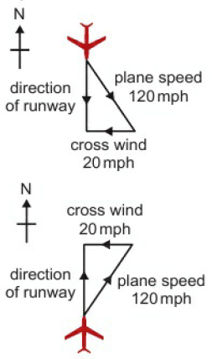
18 – Prior Knowledge Check
Page 558
* Challenge
Work out the bearing for the approach of each plane.

Slide 10
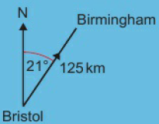
18.1 – Vectors and Vector Notation
Page 558
Objectives |  | Why Learn This?
Understand and use vector notation. Work out the magnitude of a vector. |  | You can describe journeys using vectors. For example, a flight from Bristol to Birmingham is a vector with magnitude 125 km and direction 021°.
Fluency
How far does the translation (${3 \atop 5}$) move an object in a. the x direction b. the y direction?
ActiveLearn - Homework, practice and support: Higher 18.1

Slide 11
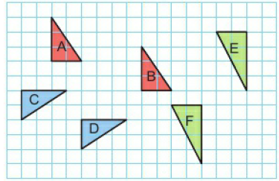
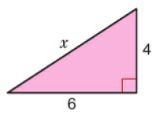
18.1 – Vectors and Vector Notation
Page 558
Work out the bearing for the approach of each plane.
A to B b. C to D
E to F
Find x in this right angled triangle. Give your answers in surd form.
Warm Up

Slide 12
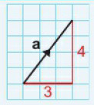
18.1 – Vectors and Vector Notation
Page 559
Key Point 1
A vector is a quantity that has magnitude and direction.
The magnitude of a vector is its size.
Displacement is change in position. A displacement can be written as (${3 \atop 4}$) where 3 is the x component and 4 is the y component. o
Examples of vectors are force (5 N acting vertically upwards) and velocity (15 km/h due north).
On squared paper draw and label these vectors.
a = (${1 \atop 3}$) b. b = (${3 \atop −2}$)
c = (${−4 \atop −3}$) b. $\vec{AB}$ = (${−5 \atop 4})$
$\vec{CD}$ = (${0 \atop 5}$)

Slide 13
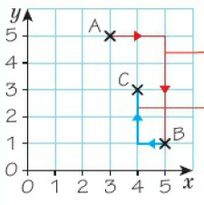
18.1 – Vectors and Vector Notation
Page 559
Key Point 2
The displacement vector from A to B is written $\vec{AB}$. Vectors are written as bold lower case letters: a, b, c When handwriting, underline the letter: a, b, c
Example 1
Point A has coordinates (3,5) and point B has coordinates (5,1). Write $\vec{AB}$ as a column vector.
The point C is such that BC = (${−1 \atop 2})$. Find the coordinates of C.
$\vec{CD}$ = (${2 \atop 4})$
The coordinates of C are (4, 3)
First mark the points on a grid. To move from A to B to 2 to the right and 4 down.
From B go 1 to the left and 2 up to find point C.

Slide 14
18.1 – Vectors and Vector Notation
Page 559
The point A is (1,2), the point B is (3,4) and the point C is (5, -1). Write as column vectors
$\vec{AB}$ b. $\vec{BC}$ c. $\vec{AC}$
Discussion What do you notice about your answers?
Q4 hint - Mark the points on a grid.
Key Point 3
Equal vectors have the same magnitude and the same direction.

Slide 15
18.1 – Vectors and Vector Notation
Page 559
Which of these vectors are equal?
Discussion Are parallel vectors always equal?
Key Point 3
The magnitude of the vector (${x \atop y})$is its length, i.e. $\sqrt{x2+y2}$
|a| means the magnitude of vector a. |OA| means the magnitude of vector OA.

Slide 16
18.1 – Vectors and Vector Notation
Page 559
Work out the magnitude of each vector. Where necessary, leave your answer as a surd.
a = (${6 \atop 8})$ b. b = (${−5 \atop 12})$
c = (${−1 \atop −3})$ d. $\vec{AB}$ = (${8 \atop 15})$
Reasoning / Communication In triangle ABC, $\vec{AB}$ = (${20 \atop −15})$ and $\vec{AB}$ = (${−7 \atop 24})$.
Work out the length of the side AB of the triangle,
Show that triangle ABC is isosceles.
Q8 hint – Sketch A, B and C.

Slide 17
18.1 – Vectors and Vector Notation
Page 559
Find the magnitude of the vector $\vec{AB}$ = (${4 \atop −5})$ Give your answer to 3 significant figures.
Reasoning $\vec{AB}$ = (${3 \atop 4})$. B is the point (2,3). Work out the coordinates of A.
9 – Exam-Style Questions
A is the point (3,4) and B is the point (-3,0).
Write $\vec{AB}$ as a column vector. (1)
Find the length of vector $\vec{AB}$. (2)
Exam hint
Write vectors in column vector form:
(${p \atop q})$ not ($\frac{4}{7})$ or (p, q)

Slide 18
18.2 – Vector Arithmetic
Page 560
Objectives |  | Why Learn This?
Calculate using vectors and represent the solutions graphically. Calculate the resultant of two vectors. |  | The driver of a car going over a road-hump instinctively works out resultant forces. A road-designer does the same, but in advance and with greater accuracy.
Fluency
The components of the column vector (${3 \atop −5})$ are 3 units … and … units …
ActiveLearn - Homework, practice and support: Higher 18.2

Slide 19
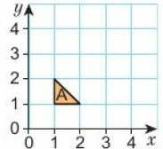
18.2 – Vector Arithmetic
Page 560
Copy shape A on a coordinate grid. Translate shape A by the vector (${0 \atop 2}$) Label this new shape B. Translate shape B by the vector (${2 \atop −1}$) Label this new shape C. What single translation maps
shape A onto shape C
shape C onto shape A?
The vector (${3 \atop −1}$) transforms shape A to shape B. What vector transforms shape B to shape A?
Warm Up
Q2 hint - Translate shape A from Q1 by (${3 \atop −2}$)

Slide 20
18.2 – Vector Arithmetic
Page 560
Reasoning The points A, B, C and D are the vertices of a quadrilateral where A has coordinates (1,1). $\vec{AB}$ = (${1 \atop 2})$, $\vec{BC}$ = (${4 \atop 1})$, and $\vec{AB}$ = (${3 \atop −1})$
Draw quadrilateral ABCD on squared paper.
Write AD as a column vector,
What type of quadrilateral is ABCD?
What do you notice about BC and AD?

Slide 21
18.2 – Vector Arithmetic
Page 561
Reasoning The points A, B, C and D are the vertices of a parallelogram. A has coordinates (1,1), $\vec{AB}$ = (${2 \atop 3})$, and $\vec{AD}$ = (${4 \atop −1})$,
Draw parallelogram ABCD on squared paper,
Write as a column vector
CB ii. BC
What do you notice?
What do you notice about
$\vec{AB}$ and $\vec{DC}$
$\vec{AD}$ and $\vec{CB}$

Slide 22
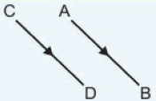
18.2 – Vector Arithmetic
Page 561
Key Point 5
If $\vec{AB}$ = $\vec{CD}$ then the line segments AB and CD are equal in length and are parallel.
$\vec{AB}$ = -$\vec{BA}$
In quadrilateral ABCD, $\vec{AB}$ = (${3 \atop 4})$, $\vec{BC}$ = (${5 \atop 0})$, $\vec{CD}$ = (${−3 \atop −4})$ and $\vec{DA}$ = (${−5 \atop 0})$ What type of quadrilateral is ABCD
Q5 hint – Look at the vectors for opposite sides.

Slide 23
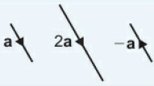
18.2 – Vector Arithmetic
Page 561
6 – Exam-Style Questions
Exam hint
Sketch a diagram
P is the point (0, 3), $\vec{PQ}$ = (${2 \atop 3})$
Find the coordinates of Q. (1)
R is the point (2, 4). QS is a diagonal of the parallelogram PQRS.
Express $\vec{PR}$ as a column vector.
$\vec{RT}$ = (${2 \atop −3})$ (3)
Calculate the length of PT. (3)
Key Point 6
2b is twice as long as a and in the same direction.
-a is the same length as a but in the opposite direction.

Slide 24
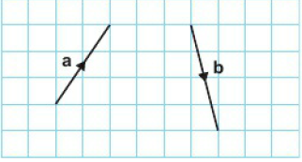
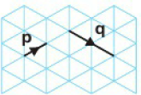
18.2 – Vector Arithmetic
Page 561
On squared paper draw vectors to represent
2a
–a
-b
3b
-2b
The vectors p and q are shown on an isometric grid. Draw these vectors on an isometric grid,
2p b. ½q
-p d. -q

Slide 25
18.2 – Vector Arithmetic
Page 561
Key Point 7
When a vector a is multiplied by a scalar k then the vector ka is parallel to a and is equal to k times a.
A scalar is a number, e.g. 3, 2, ½, -1 ...
Reasoning $\vec{AB}$ = (${2 \atop 1})$
Copy and complete to find the column vector for 2$\vec{AB},$ $2\vec{AB}$ = 2 x (${2 \atop 1})$ = (${2 x 2 \atop 2 x 1})$ = (${[ ] \atop [ ]}$)
Write down the column vector for:
$3\vec{AB}$ ii. $−4\vec{AB}$ iii. ½$\vec{AB}$

Slide 26
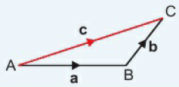
18.2 – Vector Arithmetic
Page 562
Reasoning $\vec{AB}$ = (${1 \atop 2})$ and $\vec{BC}$ = (${3 \atop 1})$. Write down the vector $\vec{AC}$ Discussion How can you find $\vec{AC}$ from $\vec{AB}$ an8d $\vec{BC}$
Key Point 8
The two-stage journey from A to B and then from B to C has the same starting point and the same finishing point as the single journey from A to C. So A to B followed by B to C is equivalent to A to C.
$\vec{AB}$ + $\vec{BC}$ = $\vec{AC}$
Triangle law for vector addition
Let $\vec{AB}$ = b, $\vec{BC}$ = b and $\vec{AC}$ = c.
Then a + b = c forms a triangle.

Slide 27
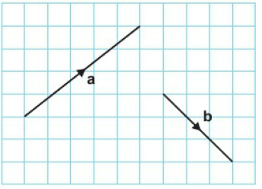
18.2 – Vector Arithmetic
Page 561
a. Find, by drawing, the sum of the vectors a and b.
Copy and complete this vector addition. a + b = a + b (${5 \atop 4}$) + (${3 \atop −3}$) = (${[ ] \atop [ ]}$)
Q11a hint - Use the triangle law of addition. Move vector b to the end of vector a so that the lines follow on.
Draw and label the vector a + b to complete the triangle.

Slide 28
18.2 – Vector Arithmetic
Page 562
a. $\vec{AB}$ = (${2 \atop 5}$) and $\vec{BC}$ = (${7 \atop −3}$). Find $\vec{AC}$.
a = (${2 \atop 5}$) and b = (${8 \atop −3}$). Find a + b.
p = (${3 \atop 4}$), q = (${−5 \atop 2}$) and r = (${2 \atop −6}$)
Work out:
p + q ii. q + p
Discussion What do you notice about your answers to parts a i and ii?
Work out
(p + q) + r
p + (q + r)
Discussion What do you notice about your answers to parts b i and ii?

Slide 29
18.2 – Vector Arithmetic
Page 563
Key Point 9
a + b = b + a
p = (${2 \atop 7}$) and q = (${−2 \atop 3}$)
Work out: p - q
a = (${1 \atop 4}$), b = (${−2 \atop 7}$) and c = (${0 \atop −3}$) Write down the column vector for:
-a b. a + b
a + b + c d. a – b
e - c
Q14 hint - p – q = p + (-q) -q = (${[ ] \atop [ ]}$)

Slide 30
18.2 – Vector Arithmetic
Page 563
Reflect Write examples to help you remember how to
a add two column vectors
subtract one column vector from another
multiply a column vector by a scalar, k.
Q16 hint – Use the column vectors (${a \atop b}$) and (${c \atop d}$)

Slide 31
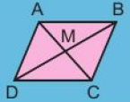
18.3 – More Vector Arithmetic
Page 560
Objectives |  | Why Learn This?
Solve problems using vectors. Use the resultant of two vectors to solve vector problems. |  | Civil engineers use vectors in road design to model the movement of a vehicle travelling along a curved section of road.
Fluency
In this parallelogram which line segments are parallel equal?
ActiveLearn - Homework, practice and support: Higher 18.3

Slide 32
18.3 – More Vector Arithmetic
Page 563
$\vec{AB}$is the column vector (${4 \atop 3}$). $\vec{BC}$ is the column vector (${2 \atop 4}$).
Find the column vector AC. Draw a diagram to show your answer,
Work out the magnitude of AC.
p = (${−2 \atop 6}$). What is -p?
Warm Up

Slide 33
18.3 – More Vector Arithmetic
Page 563
Reasoning / Communication $\vec{AB}$ = (${2 \atop 3}$), $\vec{BC}$ = (${1 \atop −4}$) and $\vec{CD}$ = (${−4 \atop 5}$).
Find the column vector for $\vec{AD}$. Draw a diagram to show this.
Show that $\vec{AC}$ = $\vec{DB}$.
a = (${5 \atop 9}$) and b = (${3 \atop 3}$). Work out the magnitude of:
a b. 2b c. a + b

Slide 34
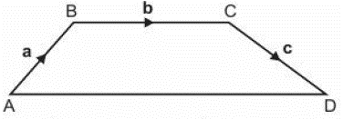
18.3 – More Vector Arithmetic
Page 563
In the quadrilateral ABCD, $\vec{AB}$ = a, $\vec{BC}$ = b and $\vec{CD}$ = c. Find in terms of a, b and c.
$\vec{AC}$ b. $\vec{AD}$
Q5a hint - $\vec{AC}$ = $\vec{A□}$ = $\vec{□C}$ = $□$ + $□$
Q5b hint - $\vec{AC}$ = $\vec{A□}$ + $\vec{□□}$ + $\vec{□D}$ = $□$ + $□$ + $□$

Slide 35
18.3 – More Vector Arithmetic
Page 564
$\vec{OA}$ = a, M is the midpoint of OA.
Write down$\vec{OM}$ in terms of a.
$\vec{OA}$ = (${2 \atop 1}$)
Express as a column vector:
$\vec{AO}$ ii $\vec{OM}$
Q6a hint – OM = $\frac{[ ]}{[ ]}$OA

Slide 36
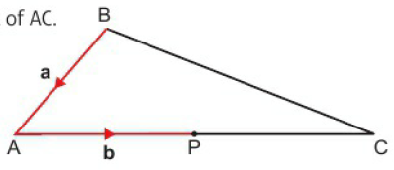
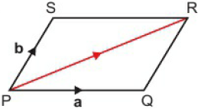
18.3 – More Vector Arithmetic
Page 564
In the diagram $\vec{BA}$ = a and $\vec{AP}$ = b. P is the midpoint of AC. Write down in terms of a and/or b.
$\vec{AC}$
$\vec{BP}$
$\vec{BC}$
Communication PQRS is a parallelogram. $\vec{PQ}$ = a and $\vec{PS}$ = b.
Explain why $\vec{SR}$ = a.
Find:
$\vec{QR}$
$\vec{PR}$

Slide 37
18.3 – More Vector Arithmetic
Page 564
Key Point 11
In parallelogram PQRS where $\vec{PQ}$ is a and $\vec{PS}$ is b, the diagonal $\vec{PR}$ of the parallelogram is a + b This is called the parallelogram law for vector addition.
When c = a + b the vector c is called the resultant vector of the two vectors a and b.

Slide 38
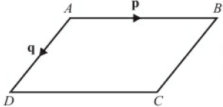
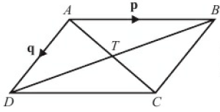
18.3 – More Vector Arithmetic
Page 564
9 – Exam-Style Questions
ABCD is a parallelogram.
AB is parallel to DC.
AD is parallel to BC.
$\vec{AB}$ = p $\vec{AD}$ = q
Express, in terms of p and q
$\vec{AC}$ ii. $\vec{BD}$ (2 marks)
AC and BD are diagonals of parallelogram ABCD. AC and BD intersect at T.
Express $\vec{AT}$ in terms of p and q.
(1 mark)
June 2006, QI3, 5525/06
Q9 strategy hint - Use the parallelogram law for vector addition

Slide 39
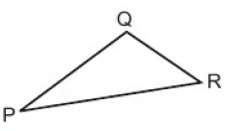
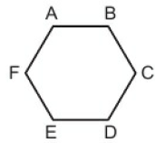
18.3 – More Vector Arithmetic
Page 565
Reasoning $\vec{PQ}$ = a and $\vec{PR}$ = b.
Write QR in terms of a and b.
Where is the point S such that $\vec{PS}$ = ½b?
Reasoning ABCDEF is a regular hexagon. $\vec{AB}$ = n
Explain why $\vec{ED}$ = n.
$\vec{BC}$ = m and $\vec{CD}$ = p.
Find i. $\vec{FE}$ ii. $\vec{AF}$
Find i. $\vec{AC}$ ii $\vec{AD}$
What is $\vec{FD}$?

Slide 40
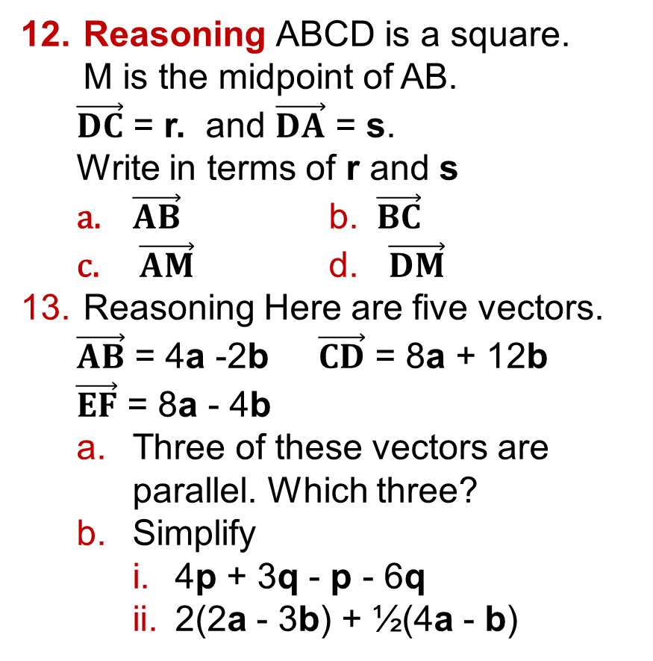
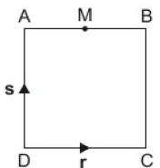
18.3 – More Vector Arithmetic
Page 565
Reasoning ABCD is a square. M is the midpoint of AB.
$\vec{DC}$ = r. and $\vec{DA}$ = s.
Write in terms of r and s
$\vec{AB}$ b. $\vec{BC}$
$\vec{AM}$ d. $\vec{DM}$
Reasoning Here are five vectors.
$\vec{AB}$ = 4a -2b $\vec{CD}$ = 8a + 12b
$\vec{EF}$ = 8a - 4b
Three of these vectors are parallel. Which three?
Simplify
4p + 3q - p - 6q
2(2a - 3b) + ½(4a - b)

Slide 41
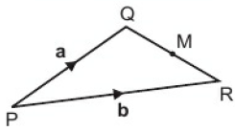
18.3 – More Vector Arithmetic
Page 565
Reasoning In triangle PQR, $\vec{PQ}$ = a and $\vec{PR}$ = b. M is the midpoint of QR. Write in terms of a and b
$\vec{QR}$ b. $\vec{QM}$ c. $\vec{PM}$
Discussion Complete the parallelogram PQSR. How can you use the parallelogram law to find $\vec{PM}$?
Q14a hint - Make use of the vectors you already know. $\vec{PM}$ = $\vec{Q□}$ + $\vec{□M}$
Simplify the expression by adding like vectors.

Slide 42
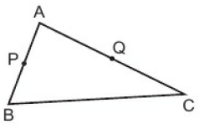
18.3 – More Vector Arithmetic
Page 565
In triangle ABC, $\vec{CD}$ = a and $\vec{AC}$ = b. P is the midpoint of AB. Q is the midpoint of AC. Write in terms of a and b
$\vec{BC}$ b. $\vec{AP}$
$\vec{AQ}$ d. $\vec{PQ}$
Discussion What do your answers show about the lines PQ and BC?

Slide 43
18.4 – Parallel Vectors and Collinear Points
Page 566
Objectives |  | Why Learn This?
Express points as position vectors. Prove lines are parallel. Prove points are collinear |  | Planes flying in formation follow parallel vector flight paths.
Fluency
Here are five vectors. Three of them are parallel. Which three? (${−2 \atop 4}$) (${6 \atop −12}$) (${−1 \atop −2}$) (${4 \atop 6}$) (${1 \atop −2}$)
ActiveLearn - Homework, practice and support: Higher 18.4

Slide 44
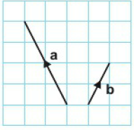
18.4 – Parallel Vectors and Collinear Points
Page 566
Here are vectors a and b. On squared paper draw the vectors
-a
a + b
2a - 3b
Work out:
(${2 \atop −1}$) + (${−3 \atop 4}$)
(${5 \atop 2}$) - (${3 \atop 1}$)
(${−2 \atop 3}$) + (${2 \atop −3}$)
Warm Up

Slide 45
18.4 – Parallel Vectors and Collinear Points
Page 566
a = (${−1 \atop 3}$), b = (${−2 \atop 4}$) and a + c = b. Calculate c.
2(${x \atop y}$) = (${3 \atop 1}$) = (${4 \atop 2}$). Find (${x \atop y}$)
e = (${5 \atop 1}$) and f = (${−1 \atop 4}$) Calculate g given that 2e – g = f
Q3 hint – let c = (${x \atop y}$)
(${−1 \atop 3}$) + (${x \atop y}$) = (${−2 \atop 4}$)
Q4 hint – 2x + 3 = □ 2y – 1 = □

Slide 46
18.4 – Parallel Vectors and Collinear Points
Page 566
O is the origin (0,0). A has coordinates (1,5) and B has coordinates (2,4). Find as column vectors:
$\vec{CD}$ b. $\vec{CD}$
$\vec{CD}$ d. $\vec{CD}$
Q6 hint – $\vec{AB}$ = $\vec{A\text{□}}$ + $\vec{B\text{□}}$
Key Point 11
With the origin 0, the vectors $\vec{OA}$ and $\vec{OB}$ are called the position vectors of the points A and B. In general, a point with coordinates {p, q) has position vector (${p \atop q}$).

Slide 47
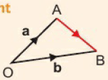
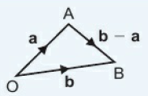
18.4 – Parallel Vectors and Collinear Points
Page 566
$\vec{OA}$ = a and $\vec{OB}$ = b. Express AB in terms of a and b.
Q7 hint –
Key Point 12
When $\vec{OA}$ = a
and $\vec{OB}$ = b, $\vec{OA}$ + $\vec{OB}$ = b - a

Slide 48
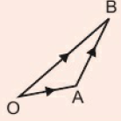
18.4 – Parallel Vectors and Collinear Points
Page 567
Example 2
The points A, B, C, and D have coordinates (1, 3), (2, 7), (-6, 10) and (-1, 10) respectively. O is the origin.
Write down the position vectors of $\vec{OA}$ and $\vec{OB}$.
Work out, as column vectors: i. $\vec{AB}$ ii. $\vec{CD}$
What do these results show about AB and CD?
$\vec{OA}$ = (${1 \atop 3}$) $\vec{OB}$ = (${2 \atop 7}$)
$\vec{AB}$ = $\vec{AO}$ + $\vec{OB}$ = $−\vec{OA}$ + $\vec{OB}$ = $\vec{OB}$ - $\vec{OA}$ = (${2 \atop 7}$) - (${1 \atop 3}$) = (${1 \atop 4}$) $\vec{CD}$ = $\vec{CO}$ + $\vec{OD}$ = $−\vec{OC}$ + $\vec{OD}$ = $\vec{OD}$ - $\vec{OC}$ = (${−1 \atop 10}$) - (${−6 \atop −10}$) = (${5 \atop 20}$)
$\vec{CD}$ = (${1 \atop 4}$) $\vec{CD}$ = (${5 \atop 20}$) = 5(${1 \atop 4}$) $\vec{CD}$ = $5\vec{AB}$
The lines CD and AB are parallel and the length of the line CD is 5 times the length of the line AB.
Position vector of (1,3) is (${1 \atop 3}$)
Use the
triangle
law
This means CD is a multiple of AB. Explain clearly when $\vec{CD}$ = 5$\vec{AB}$ means

Slide 49
18.4 – Parallel Vectors and Collinear Points
Page 567
Reasoning The points P, Q, R and S have coordinates (-2, 5), (3,1), (-6, -9) and (14, -25) respectively. O is the origin,
Write down the position vectors $\vec{OP}$ and $\vec{OQ}$.
Work out as a column vector
$\vec{PQ}$ ii. $\vec{RS}$
What do these results show about the tines PQ and RS?

Slide 50
18.4 – Parallel Vectors and Collinear Points
Page 567
9 – Exam-Style Questions
P is the point (7,5) and Q is the point (-3, 1).
Find $\vec{PQ}$ as a column vector. (1 mark)
R is the point such that $\vec{QR}$ = (${4 \atop 7}$)
Write down the co-ordinates of the point R. (2 marks)
X is the midpoint of PQ. O is the origin.
Find $\vec{OX}$ as a column vector. (2 marks)
Exam hint - In this type of vector question it can be helpful to draw a sketch.

Slide 51
18.4 – Parallel Vectors and Collinear Points
Page 567
Reasoning The point A has coordinates (1, 3), the point B has coordinates (4,5) and the point C has coordinates (-2, -4).
Write $\vec{AB}$ as a column vector,
$\vec{CD}$ = 6$\vec{AB}$. Find $\vec{CD}$.
Find the coordinates of D.
Problem-solving a = (${4 \atop 1}$) and b = (${−2 \atop 3}$). Find a vector c such that a + c is parallel to a - b.
Q10c hint -$\vec{CD}$ = $\vec{OD}$ - $\vec{OC}$
(${[ ] \atop [ ]}$) = (${x \atop y}$) - (${[ ] \atop [ ]}$)
Q11 hint - Find a - b first

Slide 52
18.4 – Parallel Vectors and Collinear Points
Page 568
Reasoning OABC is a quadrilateral in which $\vec{OA}$ = a, $\vec{OB}$ = a + 2b and $\vec{OC}$ = 2b.
Find $\vec{AB}$ in terms of a and b. What does this tell you about $\vec{AB}$ and $\vec{OC}$?
Find $\vec{BC}$ in terms of a and b. What does this tell you about $\vec{OA}$ and $\vec{BC}$?
What type of quadrilateral is OABC?
Q12 hint - Sketch a
quadrilateral OABC.

Slide 53
18.4 – Parallel Vectors and Collinear Points
Page 568
Key Point 13
$\vec{PQ}$ = k$\vec{QR}$ shows that the lines PQ and QR are parallel. Also they both pass through point Q so PQ and QR are part of the same straight line.
P, Q and R are said to be collinear (they all lie on the same straight line).
Problem-solving The points A, B and C have coordinates (2, 13), (5, 22) and (11, 40) respectively.
Find as column vectors
$\vec{AB}$ ii. $\vec{AC}$
What do these results show you about the points A, B and C?
Discussion How can you show that three points A, B, C are collinear?

Slide 54
18.4 – Parallel Vectors and Collinear Points
Page 568
Problem-solving / Communication The point P has coordinates (1, 3). The point Q has coordinates (4,6). The point R has coordinates (10,12). Show that points P, Q and R are collinear.
Reflect Explain in your own words what 'Points X, Y and Z are collinear' means.

Slide 55
18.5 – Solving Geometric Problems
Page 568
Objectives |  | Why Learn This?
Solve geometric problems in two dimensions using vector methods. Apply vector methods for simple geometric proofs. |  | Programmers use vectors to calculate collisions between objects and/or people in computer games,
Fluency
The point M is on AB such that AM:MB = 1:3. What fraction of AB is AM?
ActiveLearn - Homework, practice and support: Higher 18.5

Slide 56
18.5 – Solving Geometric Problems
Page 568
Find three pairs of parallel vectors.
$\vec{PQ}$ = 3a - 2b and $\vec{PR}$ = 9a -6b. What does this tell you about
PQ and PR
the points P, Q and R?
Warm Up
2p
p - q
3q -p
5p
4p – 8q
4q - 4p
2p – 5q
3p - q

Slide 57
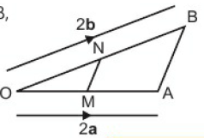
18.5 – Solving Geometric Problems
Page 569
Reasoning / Communication In triangle OAB, the point M is the midpoint of OA and the point N is the midpoint of OB. $\vec{OA}$ = 2a and $\vec{OB}$ = 2b.
Express in terms of a and/or b
$\vec{OM}$
$\vec{ON}$
$\vec{MO}$ iv. $\vec{NO}$
Express $\vec{AB}$ in terms of a and b.
Express $\vec{MN}$ in terms of a and b.
Explain what the answers to parts b and c show about AB and MN.
Q3a i hint – M is the midpoint of OA so $\vec{OM}$ = □

Slide 58
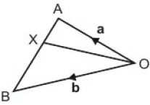
18.5 – Solving Geometric Problems
Page 569
Reasoning In triangle ABO, OA = a, and OB = b. The point X divides AB in the ratio 1:2. Express in terms of a and b
$\vec{AX}$
$\vec{OX}$
Q4b hint - $\vec{OX}$ = $\vec{OA}$ + $\vec{□}$

Slide 59
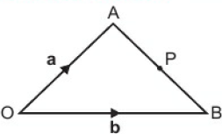
18.5 – Solving Geometric Problems
Page 569
Problem-solving In triangle OAB, $\vec{OA}$ = a and $\vec{OB}$ = b.
Find in terms of a and b the vector $\vec{AB}$.
P is the midpoint of AB.
Find in terms of a and b the vector $\vec{AP}$.
Find in terms of a and b the vector $\vec{OP}$.

Slide 60
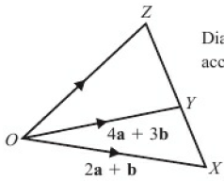
18.5 – Solving Geometric Problems
Page 569
6 – Exam-Style Questions
$\vec{OX}$ = 2a + b and $\vec{OY}$ = 4a + 3b
Express the vector $\vec{AY}$ in terms of a and b. Give your answer in its simplest form. (2)
XYZ is a straight line.
XZ = 2:3.
Express the vector $\vec{OZ}$ in terms of a and b. Give your answer in its simplest form. (3 marks)
Nov 2008, Q26. 5540H/4H
Q6b strategy hint – XY:YZ = 2:3 YZ = $\frac{[ ]}{[ ]}$XZ

Slide 61
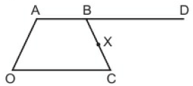
18.5 – Solving Geometric Problems
Page 570
Example 3
OABC is a quadrilateral in which $\vec{OA}$ = a, $\vec{OB}$ = a + 2b and $\vec{OC}$ = 4b.
D is the point such that $\vec{BD}$ = $\vec{OC}$ and X is the midpoint of BC.
Find in terms of a and b
$\vec{OD}$ ii. $\vec{OX}$
Explain what your answers to parts a i and a ii mean.

Slide 62
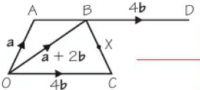
18.5 – Solving Geometric Problems
Page 570
Example 3
$\vec{OD}$ = $\vec{OB}$ + $\vec{BD}$ = a + 2b + 4b = a + 6b
$\vec{OX}\text{ = }\vec{OC}\text{ + }\vec{CX}$ $\vec{CX}$ = ½$\vec{CB}$
$\vec{CB}$ = $\vec{CO}$ + $\vec{CB}$ = a + 2b - 4b = a – 2b
$\vec{CX}$ = ½(a – 2b) = ½a – b
$\vec{OX}$ = 4b + ½a – b = ½a + 3b
$\vec{OD}$ = a + 6b = 2(½a + 3b) $\vec{OD}$ = 2$\vec{OX}$
So OD and OX are parallel with a point in common. This means that 0, X and D lie on the straight line. The length of OD is 2 times the length of OX. So X is the midpoint of OD.
Copy the diagram and mark on all the vectors.
$\vec{BD}$ = $\vec{OC}$ so BD and OC are parallel and have the same length.
To find $\vec{CX}$ you need to find $\vec{CB}$
Compare$\vec{CD}$ and $\vec{OX}$ to see if one is a multiple of the other.

Slide 63
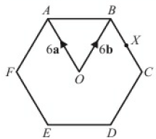
18.5 – Solving Geometric Problems
Page 571
7 – Exam-Style Questions
The diagram shows a regular hexagon ABCDEF with centre O.
$\vec{OA}$ = 6a $\vec{OB}$ = 6b
Express in terms of a and/or b
$\vec{AB}$ ii. $\vec{EF}$ (2 marks)
X is the midpoint of BC.
Express EX in terms of a and/or b. (2 marks)
Y is the point on AB extended, such that AB: BY =3:2
c Prove that E, X and Y lie on the same straight line. (3 marks)
June 2003, Q23, 5505/05

Slide 64
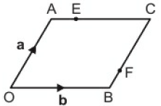
18.5 – Solving Geometric Problems
Page 571
Problem-solving / Communication OACB is a parallelogram with $\vec{OA}$ = a and $\vec{OB}$ = b. E is the point on AC such that AE = ¼AC. F is the point on BC such that BF = ¼BC.
Find in terms of a and/or b:
$\vec{AB}$ ii. $\vec{AE}$
$\vec{OE}$ iv. $\vec{OF}$
Show that EF is parallel to AB.

Slide 65
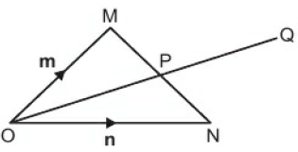
18.5 – Solving Geometric Problems
Page 571
Problem-solving / Communication In triangle OMN, $\vec{OM}$ = m and $\vec{ON}$ = n. The point P is the midpoint of MN and Q is the point such that $\vec{OQ}$ = $\frac{3}{2}\vec{OP}$.
Find in terms of m and n
$\vec{OP}$ ii. $\vec{OQ}$ iii. $\vec{OQ}$
The point R is such that $\vec{OR}$ = 3$\vec{ON}$.
Find in terms of m and n the vector $\vec{MR}$.
Explain why MQR is a straight line and give the value of $\frac{MR}{MQ}$.

Slide 66
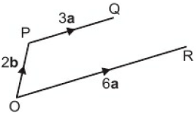
18.5 – Solving Geometric Problems
Page 571
Problem-solving / Communication In the diagram, $\vec{OR}$ = 6a, $\vec{OP}$ = 2b and $\vec{PQ}$ = 3a. The point M is on PQ such that $\vec{PM}$ = 2a. The point N is on OR such that $\vec{ON}$ = $\frac{1}{3}\vec{OR}$. The midpoint of MN is the point S.
Find in terms of a and/or b the vector NM.
Find in terms of a and/or b the vector OS.
T is the point such that $\vec{QT}$ = a. Find in terms of a and b the vector $\vec{OT}$.
Show that S lies on the line OT.
When a = (${8 \atop 2}$) and b = (${3 \atop 15}$) find the length of QR.

Slide 67
18 – Problem Solving
Page 572
Objectives | Use different problem-solving strategies and then 'explain'.
Key Point 14
There are many different problem-solving strategies. Here are some you can use:
pictures
lists
smaller numbers
bar models
x for the unknown
flow diagrams
arrow diagrams
geometric sketches
graphs
logical reasoning

Slide 68
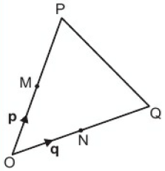
18 – Problem Solving
Page 572
Example 4
The diagram shows triangle OPQ.
M is the midpoint of OP and N is the midpoint of OQ. $\vec{OM}$ = p and $\vec{ON}$ = q.
i. Find $\vec{OP}$ and hence $\vec{PO}$. ii. Find $\vec{OQ}$ and hence $\vec{QO}$
Find $\vec{PN}$ and $\vec{QM}$.
X lies on PN such that PX = $\frac{2}{3}$PN. Y lies on QM such that QY = $\frac{2}{3}$QM. Find $\vec{OX}$ and $\vec{OY}$ Explain what your answer means

Slide 69
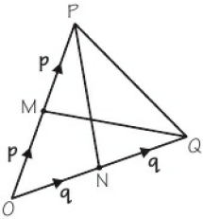
18 – Problem Solving
Page 572
Example 4
i. $\vec{OP}$ = 2p hence $\vec{PO}$ = -2p ii. $\vec{OQ}$ = 2q hence $\vec{QO}$ = -2q
$\vec{PN}$ = $\vec{PO}$ + $\vec{ON}$ = -2p + q $\vec{QM}$ = $\vec{QO}$ + $\vec{OM}$ = -2q + p = p – 2q
M is the midpoint of OP. This means OP = 2 x OM. $\vec{PO}$ is in the opposite direction and so is equal to -$\vec{OP}$
N is the midpoint of OQ. This means OQ = 2 x ON. $\vec{QO}$ is in the opposite direction and so is equal to -$\vec{OQ}$
Sketch the diagram. Write on the diagram all the vectors you know. Join PN, join QM
Look at the diagram. Move from P to N and from Q to M along vectors you know.

Slide 70
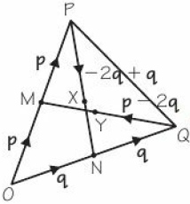
18 – Problem Solving
Page 573
Example 4
$\vec{OX}$ =$\vec{OP}$ + $\vec{PX}$ = $\vec{OP}$ + $\frac{2}{3}\vec{PN}$ = 2p + $\frac{2}{3}$(-2p + q) = 2p + $\frac{4}{3}$p + $\frac{2}{3}$q = $\frac{2}{3}$p + $\frac{2}{3}$q $\vec{OY}$ =$\vec{OQ}$ + $\vec{QY}$ = $\vec{OQ}$ + $\frac{2}{3}\vec{QM}$ = 2q + $\frac{2}{3}$(-2p - 2q) = 2q + $\frac{2}{3}$p - $\frac{4}{3}$q = $\frac{2}{3}$p + $\frac{2}{3}$q $\vec{OX}$ = $\vec{OY}$ $\frac{2}{3}$p + $\frac{2}{3}$q
This means that X and Y are the same point.
Write on your diagram all the vectors you found in part b. Mark X and Y.
Look at your diagram. Move from 0 to X along vectors you know.
Simplify
Look at your diagram. Move from 0 to Y along vectors you know.
Simplify
Write a sentence to explain what this means.

Slide 71
18 – Problem Solving
Page 573
In triangle OAB, $\vec{OA}$ = a and $\vec{OB}$ = b. X lies on OA such that OX = ¼OA. Y lies on OB such that OY = ¼OB. Find
$\vec{AB}$
i. $\vec{OX}$ ii. $\vec{OY}$ iii. $\vec{XY}$
Explain what your answers to parts a and b iii show about AB and XY.
Q1 hint - Sketch a diagram of the triangle. Write on your diagram all the vectors you know. Mark X and Y.
Q1b hint - Write on your diagram all the vectors you have found so far.

Slide 72
18 – Problem Solving
Page 573
Anna, Beth, Cara and Dana are in the final of a solo singing competition. Anna says, 'There are twelve possible results for first and second place.‘ Dana says, There are four of us in the competition and two places for first and second, so there are only eight possible results.‘ Who is correct? Explain.
Q2 hint - You could list all possible results to help you solve the problem. Work logically so you don't miss any.

Slide 73
18 – Problem Solving
Page 573
An aircraft pilot records the air temperature, in °C, at different heights (in metres) above sea level. The table shows three of his results. The pilot predicts that the temperature at 2500 m above sea level will be -7°C. Explain.
Height above sea level (m) | 500 | 1400 | 2000
Temperature (°C) | 13 | 4 | -2
Q3 hint - You could use a graph to help you solve the problem.

Slide 74
18 – Problem Solving
Page 573
Two dog walkers meet at the corner of a park, 350 m x 235 m. They are both heading to the opposite corner. They set off at the same time. The spaniel walker takes a path along two adjacent sides of the park, and walks at an average pace of 5.2 km/h. The Labrador walker takes a different path across the diagonal of the park and walks at an average pace of 4.3 km/h. Which dog walker gets to the opposite corner first? Explain.
Q4 hint - You could use a geometric sketch to help you solve the problem.

Slide 75
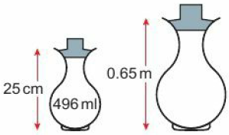
18 – Problem Solving
Page 574
These urns of sunflower oil are mathematically similar. Maria says, 'The large urn holds 1 litre 290 millilitres (to the nearest millilitre)'. Alexandra says, 'The large urn holds 8 litres 718 millilitres (to the nearest millilitre)'. Who is correct? Explain.
Q5 hint - Volume scale factor = (linear scale factor)³ You could use an arrow diagram to help you solve the problem Height Volume Small Bottle Marge Bottle
x □ x□

Slide 76
18 – Problem Solving
Page 574
Finance Ross earns a bonus. It is 15% of his annual salary. He spends 40% of his bonus on a holiday and j of the remainder on a laptop. £1890 of his bonus is left. Antony also earns a bonus. It is 12.5% of his annual salary. He spends 45% of his bonus on a holiday and } of the remainder on a lawnmower. £1650 of his bonus is left. Who earns the bigger annual salary? Explain.
Q6 hint - You could use bar models (one for Ross and one for Antony) to help you solve the problem.

Slide 77
18 – Problem Solving
Page 574
Every autumn, orchard owners employ apple pickers. Each day, an apple picker picks, on average, 15 bags of apples. Each bag of apples weighs, on average, 18kg. The apples are packed into trays that, on average, contain 620g of apples. One orchard owner's target is to have 10800 trays of apples at the end of every day. He says that to achieve this he must employ at least 25 apple pickers. Explain.
Reflect What clues are there in a question that help you decide which problem-solving strategy to use?
Q7 hint - Vou could use x for the unknown. Read each sentence, one at a time, to build an equation that you can solve for x. Beware of different units.

Slide 78
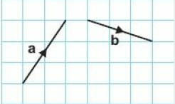
18 – Check Up
Page 574
18. Check up | Log how you did on your Student Progression Chart
Vector Notation
The diagram shows two vectors a and b. Write a and b as column vectors.
a. A is the point (1,4) and AB = (${2 \atop 3}$) Find the coordinates of B.
C is the point (4,3) and D is the point (7, -2). Express $\vec{CD}$ as a column vector.

Slide 79
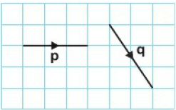
18 – Check Up
Page 574
Find the magnitude of the vector (${−3 \atop 5}$) Give your answer in surd form.
Vector Arithmetic
The diagram shows two vectors p and q. On squared paper draw vectors to represent
2q b. p + q c. p - q

Slide 80
18 – Check Up
Page 575
$\vec{AB}$ = (${3 \atop −1}$) and $\vec{BC}$ = (${−5 \atop 4}$). Find $\vec{AC}$.
a = (${4 \atop −2}$) and b = (${−1 \atop 6}$). Find
a + b b. b - a
3a
p = (${5 \atop −1}$) and q = (${9 \atop −3}$) p + 2r = q Find r as a column vector.

Slide 81
18 – Check Up
Page 575
Geometric Problems
Which of these vectors are parallel to:
a - b b. a + b
P is the point (4, -3) and Q is the point (-2, 7).
Write down the position vector, p, of the point P.
Write down the position vector, q, of the point Q.
Work out $\vec{PQ}$.
3a + 3b
2a - b
3a – 3b
½a - ½b

Slide 82
18 – Check Up
Page 575
Reasoning The points A, B and C have coordinates (2,13), (5, 22) and (11,40) respectively,
Find as column vectors
$\vec{AB}$ ii. $\vec{AC}$
What do these results show about the points A, B and C?

Slide 83
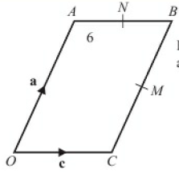
18 – Check Up
Page 575
11 – Exam-Style Questions
OABC is a parallelogram.
M is the midpoint of CB.
N is the midpoint of AB.
$\vec{OA}$ = a
$\vec{OC}$ = c
Find, in terms of a and/or c, the vectors
$\vec{MB}$
$\vec{MN}$ (2 marks)
Show that CA is parallel to MN.
(2 marks)
May 2008, Q25, 5540H/3H

Slide 84
18 – Check Up
Page 575
How sure are you of your answers? Were you mostly Just guessing ☹ Feeling doubtful 😐 Confident ☺ What next? Use your results to decide whether to strengthen or extend your learning.
* Challenge
p and q are two vectors such that
p ≠ q
magnitude of p + q = magnitude of p - q
Show that p and q are perpendicular vectors.
Reflect

Slide 85
18 – Strengthen
Page 576
18. Strengthen | Log how you did on your Student Progression Chart
Vector Notation
Write down the column vector that describes each transformation.
A to B b. B to A
A to C d. A to D

Slide 86
18 – Strengthen
Page 576
Write these as column vectors,
$\vec{OA}$ b. $\vec{OB}$
Q2 hint - $\vec{OA}$ is the vector that translates O to A.

Slide 87
18 – Strengthen
Page 576
P is the point (2, 3) and $\vec{PQ}$ = (${1 \atop 5}$) Find the coordinates of Q.
A is the point (4, 2). B is the point (7,1). Express $\vec{AB}$ as a column vector.
Q3 hint - Plot the point P on a grid. From P move 1 unit across and 5 units up to find the position of Q.
Q4 hint - Plot the points A and B on a grid. Write the column vector that translates A to B.

Slide 88
18 – Strengthen
Page 576
a. Copy and complete the diagram to show the vector (${2 \atop −5}$)
Use Pythagoras' theorem to work out the magnitude of the vector (${2 \atop −5}$) the length of the hypotenuse of the triangle). Give your answer in surd form.
Find the magnitude of each vector, giving your answers in surd form.
(${3 \atop −4}$) b. (${−9 \atop 5}$)
(${9 \atop 7}$) d. (${−3 \atop −5}$)
Q6 hint - Use the method from Q5.

Slide 89
18 – Strengthen
Page 577
Vector arithmetic
The diagram shows the vector a. On squared paper draw vectors to represent
2a b. 3a
½a d. -a
Q1a hint – Draw vector a twice end to end.
Q1d hint –a is the opposite direction to a.

Slide 90
18 – Strengthen
Page 577
The diagram shows the vectors b and c. On squared paper draw vectors to represent
b + c b. b - c
Q2a hint

Slide 91
18 – Strengthen
Page 577
a = (${3 \atop 4}$) and b = (${1 \atop 2}$)
On squared paper draw the vectors
a ii b iii a + b iv. a - b
Use your answers to part a to write as column vectors
a + b ii. a - b iii. 2a + b
Work out
a + b = (${3 \atop 4}$) + (${1 \atop 2}$) = (${3 + 1 \atop 4 + 2}$)
a – b = c = (${3 \atop 4}$) - (${1 \atop 2}$),
2a + b = 2(${3 \atop 4}$) - (${1 \atop 2}$)
What do you notice about your answers to parts b and c?

Slide 92
18 – Strengthen
Page 577
a = (${3 \atop 2}$) and b = (${−1 \atop 4}$). Calculate:
2a + b b. a - 3b
4a + 2b d. 3(a – b)
$\vec{AB}$ = (${2 \atop 4}$), $\vec{BC}$ = (${4 \atop −1}$) and $\vec{CD}$ = (${−5 \atop 3}$). Work out:
$\vec{AB}$ + $\vec{BC}$ b. $\vec{BC}$ + $\vec{CD}$
$2\vec{AB}$ + $\vec{CD}$
a = (${2 \atop 7}$), b = (${−1 \atop −3}$) and a – x = b. Find x as a column vector.

Slide 93
18 – Strengthen
Page 578
Geometrical problems
Draw two parallel lines of the same length on a squared grid. Write their column vectors. What do you notice about the vectors of parallel lines? Draw some more pairs of parallel lines to check your findings.
Which vectors are parallel? (${6 \atop 6}$) (${2 \atop 3}$) (${1 \atop 3}$) (${4 \atop 5}$) (${−4 \atop −6}$) (${2 \atop −3}$) (${8 \atop 12}$)
Q3 hint - For any number k,
-$\vec{AB}$ and k$\vec{AB}$ are parallel to $\vec{AB}$.

Slide 94
18 – Strengthen
Page 578
Which vectors are parallel?
$\vec{AB}$ = (${4 \atop 1}$), $\vec{BC}$ = (${−3 \atop 2}$), and $\vec{CD}$ = (${2 \atop −5}$)
On squared paper draw a diagram to show ABCD.
Find the column vector for $\vec{AD}$
Show that $\vec{AC}$ = $\vec{DB}$.
What does this tell you about the vectors $\vec{AC}$ and $\vec{DB}$?
a + b
2(a + b)
3a + 3b
a - b
2a + b
a + 2b
2a + 2b
Q2 hint – For any number k, -a and ka are parallel to a.
Q5a hint

Slide 95
18 – Strengthen
Page 578
ABCD is a trapezium. $\vec{AB}$ = a and $\vec{AD}$ = b.
CD is parallel to AB. What does this tell you about the vectors $\vec{AB}$ and $\vec{CD}$?
CD = 2AB. Copy and complete $\vec{CD}$ = □$\vec{AB}$ = □
Copy and complete $\vec{BC}$ = $\vec{BA}$ + □ + □ = -a + □ + □ Simplify your answer by collecting like vectors.
Q4c hint – Trace around the diagram.

Slide 96
18 – Strengthen
Page 578
Problem-solving A, B and C are collinear.
Write down the column vectors
$\vec{AB}$ ii. $\vec{BC}$
How do these vectors show that AB and BC are collinear? P is the point with coordinates (3, -2).
P is the point with coordinates (5, -1).
Write down the position vector, p, of the point P.
Write down the position vector, q, of the point Q.
Work out $\vec{PQ}$.
Q7 hint - Plot 0(0,0), P and Q on a coordinate grid. $\vec{OP}$? is the vector that translates O to P.

Slide 97
18 – Strengthen
Page 579
A is the point (4,1), B is the point (8,4) and C is the point (20,13).
Find $\vec{AB}$ and $\vec{BC}$.
Show that AB and BC are parallel,
Copy and complete: AB and BC are ________ and both pass through the point _____. So, ABC is a __________ line and A, B, C are collinear.

Slide 98
18 – Strengthen
Page 579
OAB is a triangle. C is the midpoint of OA. D is the midpoint of AB. $\vec{OA}$ = a and $\vec{OB}$ = b.
Write $\vec{OC}$ in terms of a.
Find $\vec{BA}$ in terms of a and b.
Find $\vec{BD}$ in terms of a and b.
Find $\vec{OD}$ in terms of a and b.
Find $\vec{CD}$ in terms of a and b.
Show that CD is parallel to OB.
Q9b hint – Trace around the diagram.
Q9c hint – BD = BA
$$\frac{□}{□}$$

Slide 99
18 – Strengthen
Page 579
Reasoning $\vec{OA}$ = a, $\vec{OB}$ = b and AP: PB = 3:2.
Copy and complete AP = $\frac{[ ]}{[ ]}$AB BP = $\frac{[ ]}{[ ]}$BA
Express in terms of a and b
$\vec{AB}$ ii. $\vec{AP}$
$\vec{BA}$
$\vec{PB}$
$\vec{OP}$

Slide 100
18 – Extend
Page 579
The diagram shows vectors a and b. On isometric paper draw the vectors
a + b
b - a
2b + a
½a
½a + 2b
Reasoning a A is the point (1,3) and $\vec{AB}$ = (${3 \atop 2}$) Find the coordinates of B.
C is the point (4,3). BD is a diagonal of the parallelogram ABCD. Express $\vec{BD}$ as a column vector,
$\vec{CE}$ = (${1 \atop −3}$) Find the coordinates of E.

Slide 101
18 – Extend
Page 579
On this grid, $\vec{OA}$ = a and $\vec{OB}$ = b. Write in terms of a and b
$\vec{OM}$ b. $\vec{OH}$
$\vec{MN}$ d. $\vec{KE}$
$\vec{AB}$ f. $\vec{CM}$
$\vec{DI}$ h. $\vec{ME}$

Slide 102
18 – Extend
Page 580
P is the point (2, 2) and Q is the point (6,1).
Write down the vector $\vec{PQ}$ as a column vector.
PQRS is a parallelogram. $\vec{PR}$ = (${2 \atop 5}$)
Find the vector $\vec{QS}$ as a column vector,
Find the magnitude of vector $\vec{QS}$.

Slide 103
18 – Extend
Page 580
ORS is a triangle. ST = $\frac{2}{3}$SR $\vec{OS}$ = a and $\vec{OR}$ = b.
Write down an expression for $\vec{SR}$ in terms of a and b.
Express $\vec{OT}$ in terms of a and b.
Give your answer in its simplest form.

Slide 104
18 – Extend
Page 580
Reasoning OABC is a trapezium. $\vec{OA}$ = a and $\vec{OC}$ = c. CB is parallel to OA and CB = 2OA. M is the midpoint of AB and X divides CB in the ratio 2:3. Write in terms of a and c
$\vec{CB}$ b. $\vec{OM}$
$\vec{AB}$
$\vec{OX}$
Q9 strategy hint - Show that N, M and C are collinear.

Slide 105
18 – Extend
Page 580
Problem-solving JKLM is a parallelogram. The diagonals of the parallelogram intersect at O. $\vec{OJ}$ = j and $\vec{OK}$ = k.
Write an expression, in terms of J and k, for
$\vec{IJ}$ ii. $\vec{KJ}$ iii. $\vec{KL}$
X is the point such that $\vec{OX}$ = 2j - k.
i. Write down an expression, in terms of j and k, for $\vec{JX}$.
Explain why J, K and X lie on the same straight line.
Q7 strategy hint - To do this question you need to remember the properties of a parallelogram, i.e. the diagonals bisect each other.

Slide 106
18 – Extend
Page 581
8 – Exam-Style Questions
APB is a triangle. N is a point on AP.
$\vec{AB}$= a $\vec{AN}$ = 2b $\vec{NP}$ = b
Find the vector PB, in terms of a and b. (1 mark)
B is the midpoint of AC.
M is the midpoint of PB.
Show that NMC is a straight line. (4 marks)
Nov 2012, Q28, 1MA0/1H

Slide 107
18 – Extend
Page 581
Problem-solving OPQ is a triangle. $\vec{OP}$ = 2p $\vec{OQ}$= 3q
Find $\vec{PQ}$ in terms of p and q.
R is the point on PQ such that PR:RQ = 2:3.
Show that $\vec{OR}$ is parallel to the vector p + q.
Q9b strategy hint - Show that N, M and C are collinear.

Slide 108
18 – Extend
Page 581
Reasoning PQR is a triangle. S is the point on RQ such that RS:SQ = 3:2. $\vec{PQ}$ = a and $\vec{PR}$ = b.
Write down an expression for $\vec{RQ}$ in terms of a and b.
Express $\vec{SP}$ in terms of a and b.
Q11b hint - $\vec{SP}$ = $\vec{SQ}$ + $\vec{QP}$ Work out what SQ is as a fraction of RQ.

Slide 109
18 – Extend
Page 581
Problem-solving OPQ is a triangle. B is the midpoint of PQ. $\vec{OA}$ = 3p, $\vec{AP}$ = p, $\vec{OQ}$ = 2q and $\vec{QC}$ = q.
Find, in terms of p and q, the vectors
$\vec{PQ}$ ii. $\vec{AC}$
$\vec{QC}$
Hence explain why ABC is a straight line.
The length of AB is 3 cm.
Find the length of AC.
Q11b communication hint - ‘Hence’ means you should use your answers to part a to help you answer part b.

Slide 110
18 – Extend
Page 582
12 – Exam-Style Questions
ABCDEF is a regular hexagon, with centre O.
$\vec{OA}$ = a, $\vec{OB}$ = b.
Write the vector $\vec{AB}$ in terms of a and b. (1 mark)
The line AB is extended to the point K so that AB: BK =1:2
Write the vector CK in terms of a and b. Give your answer in its simplest form. (3 marks)
March 2012, Q23, I380/3H
Q12b strategy hint - Copy the diagram. Extend AB to K. Draw the line DK.

Slide 111
18 – Extend
Page 582
13 – Exam-Style Questions
OAYB is a quadrilateral.
$\vec{OA}$ = 3a $\vec{OB}$ = 6b
Express AB in terms of a and b. (1 mark)
X is the point on AB such that AX: XB = 1:2 and 6 T = 5a - b
Prove that $\vec{OX}$= $\frac{2}{5}\vec{OY}$ (4 marks)
March 2013, Q26, 1MA0/1H
Q13b strategy hint – Find expressions for $\vec{OX}$ and $\vec{OY}$ in terms of a and b.

Slide 112
18 – Knowledge Check
Page 582
18 – Knowledge Check
A vector is a quantity that has magnitude and direction. For example, velocity is a vector because it describes how fast something is moving and in which direction. The magnitude of a vector is its size. Displacement is change in position. A displacement can be written as (${3 \atop 4}$) where 3 is the x component and 4 is the y component. The displacement vector from A to B is written $\vec{AB}$. Vectors are written as bold lower case letters: a, b, c. When handwriting, underline the letter: a, b, c. Equal vectors have the same magnitude and the same direction. The magnitude of the vector (${x \atop y}$) is its length, i.e. $\sqrt{x2+y2}$
Mastery Lesson 18.1
Mastery Lesson 18.1
Mastery Lesson 18.1
Mastery Lesson 18.1

Slide 113
18 – Knowledge Check
Page 583
18 – Knowledge Check
If $\vec{AB}$ = $\vec{CD}$ then the line segments AB and CD are equal in length and are parallel. $\vec{AB}$ = -$\vec{BA}$ 2a is twice as long as a and in the same direction. -a is the same length as a but in the opposite direction. When a vector a is multiplied by a scalar k then the vector ka is parallel to a and is equal to k times a. A scalar is a number, e.g. 3, 2, ½, -1
Mastery Lesson 18.2
Mastery Lesson 18.2
Mastery Lesson 18.2

Slide 114
18 – Knowledge Check
Page 583
18 – Knowledge Check
The two-stage journey from A to B and then from B to C has the same starting point and the same finishing point as the single journey from A to C. So A to B followed by B to C is equivalent to A to C. $\vec{AB}$ + $\vec{BC}$ = $\vec{AC}$. Triangle law for vector addition: Let $\vec{AB}$ = a, $\vec{BC}$ = b and $\vec{AC}$ = c. Then a + b = c forms a triangle. a + b = b + a. Parallelogram law for vector addition: In parallelogram PQRS where $\vec{PQ}$ is a and $\vec{PS}$ is b, the diagonal $\vec{PR}$ of the parallelogram is a + b
Mastery Lesson 18.2
Mastery Lesson 18.2
Mastery Lesson 18.3

Slide 115
18 – Knowledge Check
Page 584
18 – Knowledge Check
When c = a + b the vector c is called the resultant vector of the two vectors a and b. With the origin O, the vectors $\vec{OA}$ and $\vec{OB}$ are called the position vectors of the points A and B. In general, a point with coordinates (p, q) has position vector (${p \atop q}$) When $\vec{OA}$ = a and $\vec{OB}$ = b, $\vec{AB}$ = $\vec{AO}$ + $\vec{OB}$ = b - a. $\vec{PQ}$ = k$\vec{OR}$ shows that the lines PQ and QR are parallel. Also they both pass through point Q so PQ and QR are part of the same straight line. P, Q and R are said to be collinear (they all lie on the same straight line).
Mastery Lesson 18.3
Mastery Lesson 18.4
Mastery Lesson 18.4
Mastery Lesson 18.4

Slide 116
18 – Knowledge Check
Page 584
18 – Knowledge Check
Think back to all units where you have been asked to prove things. Choose A B or C to complete each statement: I am A good at proof B OK at proof C not very good at proof I think proof is ... A easy B OK C hard When I think about doing a proof, I feel A confident B OK C unsure Did you answer mostly As and Bs? Are you surprised by bow you feel about proof? Why? Did you answer mostly Cs? Find the three questions about proof that you found the hardest. Ask someone to explain them to you. Then complete the statements above again
Reflect
Hint - You may choose proof questions from this unit or another unit. You could look back at Units 12 and 16 too.

Slide 117
18 – Unit Test
Page 584
18. Unit Test | Log how you did on your Student Progression Chart
a = (${2 \atop −3}$) b = (${5 \atop 4}$) Write as a column vector:
5a (1 mark)
a - b (1 mark)
2a – 3b (2 marks)
The diagram shows two vectors a and b. $\vec{PQ}$ = a + 2b Draw the vector $\vec{PQ}$ on squared paper. (3 marks)

Slide 118
18 – Unit Test
Page 585
ABCD is a parallelogram. D is the midpoint of AE. $\vec{AB}$ = p and $\vec{AD}$ = q. Write down in terms of p and/or q
$\vec{AE}$ (1 mark)
$\vec{AC}$ (1 mark)
Reasoning a A is the point (2, 5) and $\vec{AB}$ = (${6 \atop −2}$). Find the coordinates of B. (1 mark)
C is the point (5, 1). BD is a diagonal of the parallelogram ABCD. Express $\vec{BD}$ as a column vector. (2 marks)

Slide 119
18 – Unit Test
Page 585
The diagram is a sketch. P is the point (1, 4). Q is the point (3, 6).
Find the vector $\vec{PQ}$. Give your answer as a column vector. (2 marks)
M is the midpoint of PQ. N is the midpoint of QR.
Find the vector MN. Give your answer as a column vector.

Slide 120
18 – Unit Test
Page 585
Reasoning ABCDEF is a regular hexagon. $\vec{AB}$ = a, $\vec{BC}$ = b and $\vec{FC}$ = 2a.
Find in terms of a and b
$\vec{FE}$ ii. $\vec{CE}$ (2 marks)
CE = EX
Prove that FX is parallel to CD. (3 marks)

Slide 121
18 – Unit Test
Page 585
Reasoning OPQR is a trapezium.
OR is parallel to PQ. $\vec{OP}$ = p and $\vec{OR}$ = r. PQ = 2OR
X is the point on PQ such that PX:XQ = 3:1. Express $\vec{OX}$ in terms of p and q. (3 marks)

Slide 122
18 – Unit Test
Page 586
8 – Exam-Style Questions
OACB is a parallelogram. $\vec{OA}$ = a and $\vec{OB}$ = b
D is a point such that $\vec{AC}$ = $\vec{CD}$
The point N divides AB in the ratio 2:1
Write an expression for $\vec{ON}$ in terms of a and b. (3 marks)
Prove that OND is a straight line. (3)
Nov 2013, Q24, 1MA0/IH

Slide 123
18 – Unit Test
Page 586
A is the point (3, 4) and B is the point (-1,0).
Express $\vec{AB}$ as a column vector. (1 mark)
$\vec{CD}$ = (${2 \atop 5}$)
Write down the coordinates of point C. (1 mark)
X is the midpoint of AB. 0 is the origin.
Find $\vec{OX}$ as a column vector. (2 marks)
What is the magnitude of $\vec{AB}$? (2 marks)

Slide 124
18 – Unit Test
Page 586
Exam-Style Questions
Sample student answer
What mistake has the student made?
How could you improve this answer?
Student Answer
$\vec{OA}$ = 2m
$\vec{OB}$ = 2n
$\vec{AB}$ = 2m + 2n = 2(m + n) $\vec{MN}$ = m + n
So $\vec{AB}$ = 2$\vec{MN}$
OAB is a triangle.
M is the midpoint of OA.
N is the midpoint of OB.
$\vec{OM}$= m $\vec{OV}$ = n
Show that AB is parallel to MN. (3 marks) June 2014, Q24, IMA0/1H

